Slide 1
Reference to a Static Method
Method reference is used to refer method of functional interface.
We can refer to static method defined in the class. Following is the syntax
ContainingClass::staticMethodName

Slide 2
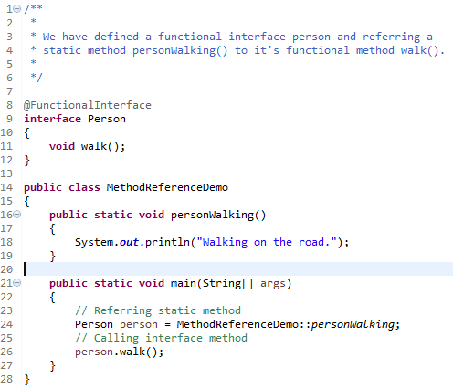
Reference to a Static Method
Referring

